Slide 1
Bitcoin Price and Sentiment Analysis
Connor Beard, Mishuk Dutta
Notes:
Talk about project here.

Slide 2
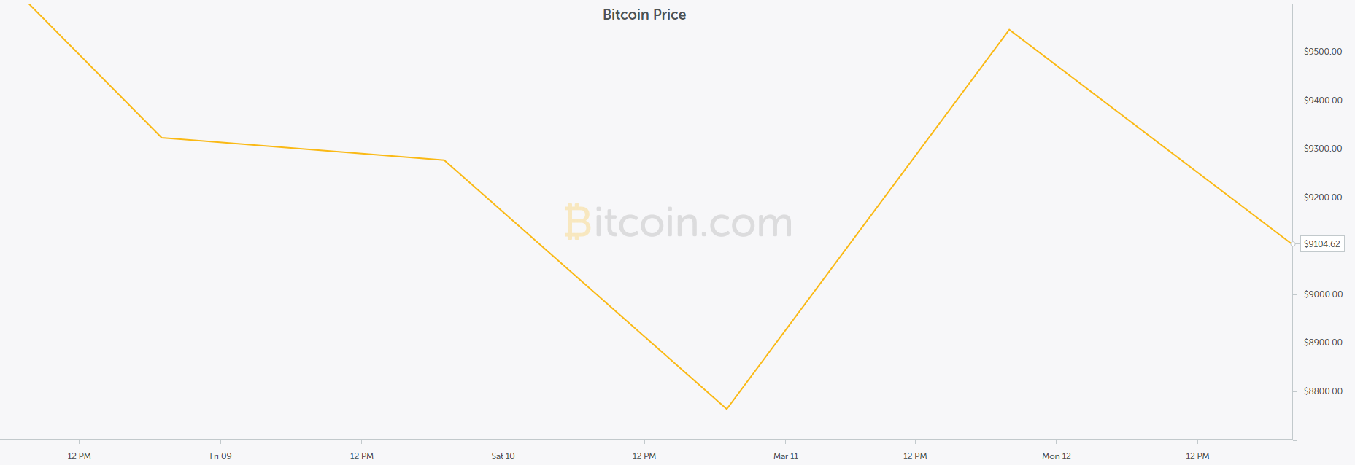
Bitcoin’s Price
Has value because it is scarce and useful
Much like gold
Price is determined solely by supply and demand
Similar to stocks
Volatile
4 days, $800
change in price

Slide 3
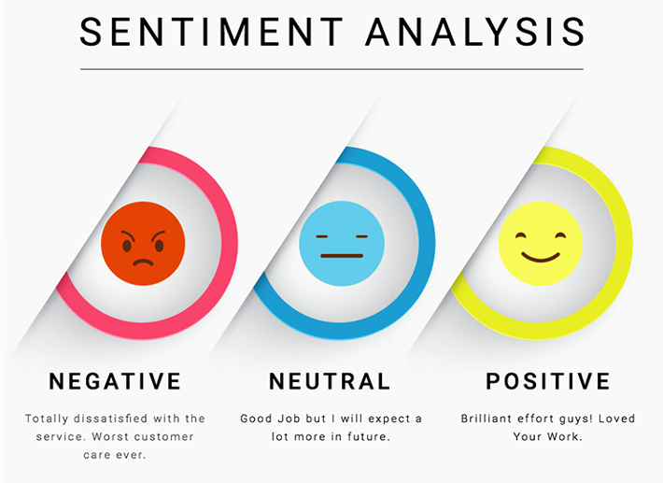
Our Project
Limited knowledge of Bitcoin’s technology
Bitcoin still popular due to success
Investors from all different backgrounds
We seek to predict Bitcoin’s price by using the public’s current sentiment on it
Believe people will buy and sell based on how it is currently perceived
Some invest due to technology but most due to fast money
Hope to be able to better predict the volatility of the price using the collective sentiment of the public
Use social media to gather the public’s sentiment

Slide 4
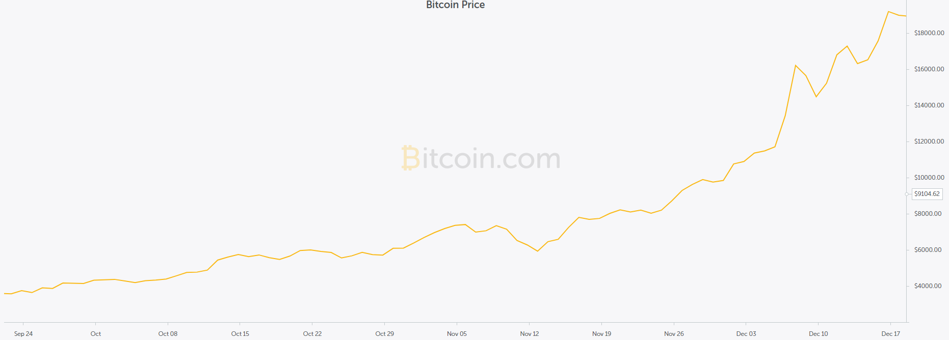
Why is it interesting / important?
Real world challenge
If one can predict one can profit
Can social media accurately reflect public opinion?
Is Bitcoin’s price entirely based on the opinion of people?

Slide 5
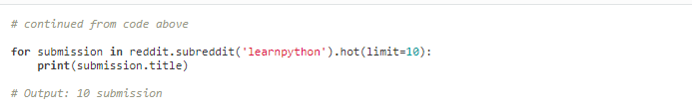
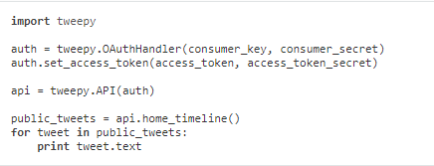

Tools for gathering data
Twitter - Tweepy (http://docs.tweepy.org/en/v3.5.0/)
‘#Bitcoin’ - 200 most recent tweets for 7 days
Reddit - Praw (https://praw.readthedocs.io/en/latest/)
Bitcoin Subreddit - all posts within a 8 day time frame
Sentiment Analysis - Vader (https://github.com/cjhutto/vaderSentiment)
Designed for Social Media sentiment, pre-trained

Slide 6
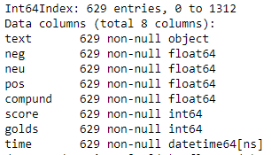
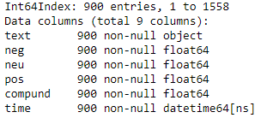
Handling Data
Data stored
Twitter: 2/28 - 3/07 (~1600 tweets)
Reddit: 2/28 - 3/08 (~1300 posts)
Text cleaned
Sentiment values (pos, neg, neu, compound
Date and time
Processing
Removed all 0 sentiment posts / tweets

Slide 7
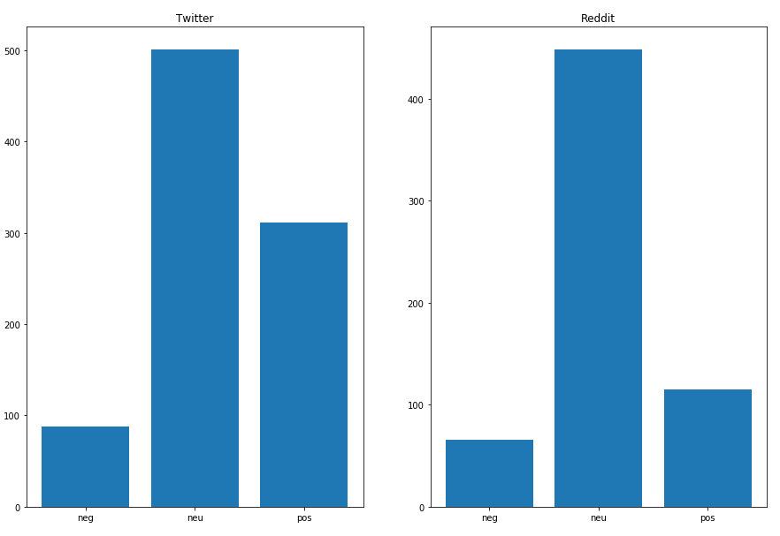
EDA (Sentiment)

Slide 8
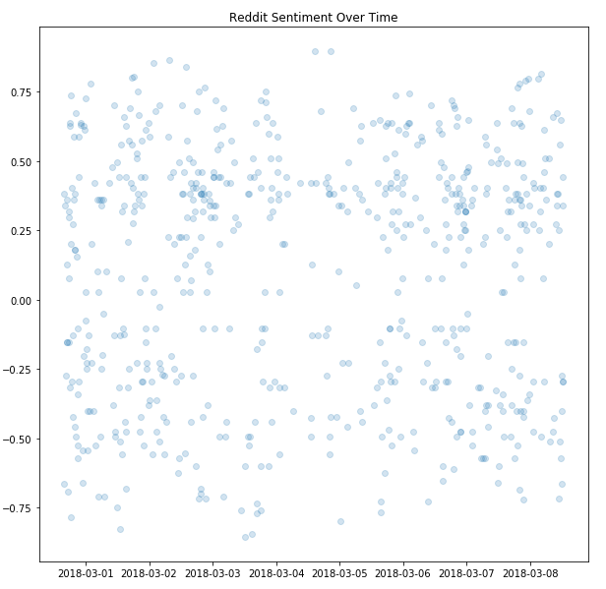
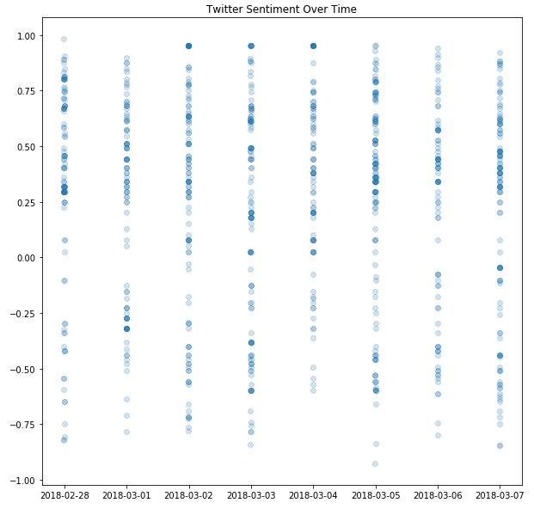
EDA (scatter senti over time)

Slide 9
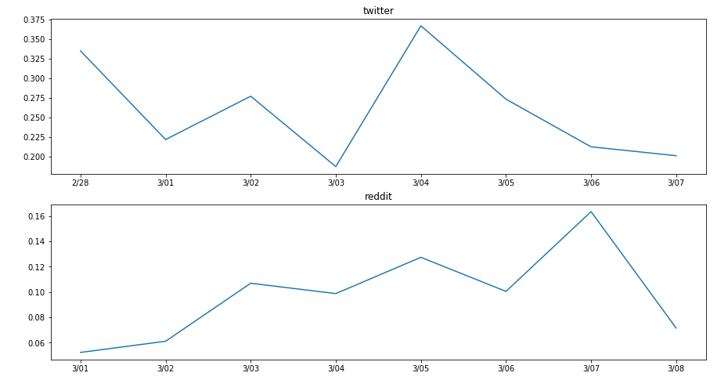
EDA (Average sentiment over time)

Slide 10
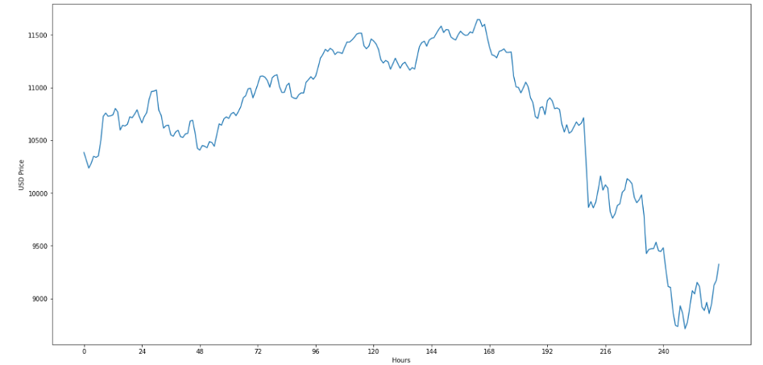
EDA (Bitcoin over time)

Slide 11
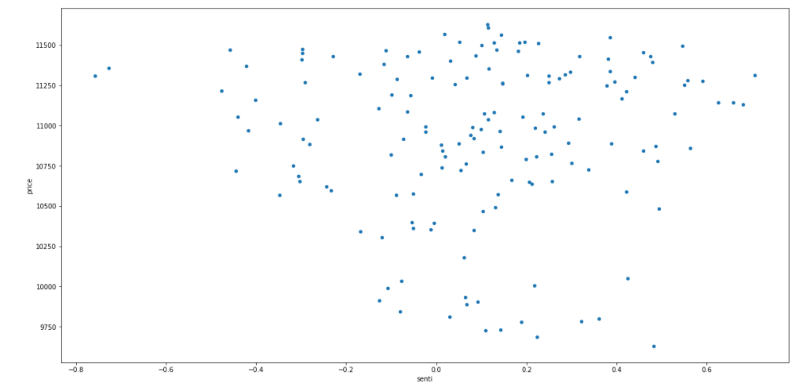
Reddit Scatter (Senti and Price by hour)

Slide 12
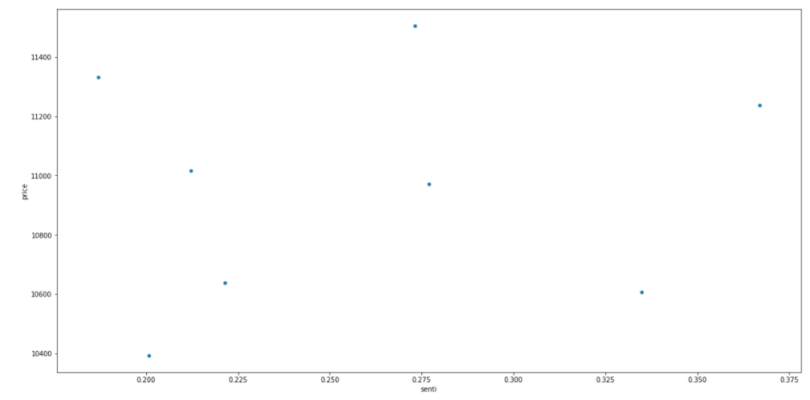
Twitter Scatter (Senti and Price by day)

Slide 13
What’s Next
Apply regression to see if we can predict price based off sentiment
Look at different features to add to create different models
Look at using sentiment as a number vs. as a category
Find the best model for our data

